Slide 1
AWS

Slide 2
L2

Slide 3
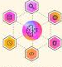






Intelligent Digital Brain on AWS —Agentic Execution Flow (L2)
1
The brain interaction with external world applications happens through agentic orchestration supported by specialized agents
Marketing Apps
Initiate domain requests through agent-driven orchestration.
Sales Apps
Invoke the Brain for contextual reasoning and next-best actions.
Finance Apps
Support complex decisions with knowledge-grounded intelligence.
2
Agents have access to models, tools and knowledge through a set of AI gateways that act as control points
1
Agent Orchestration
Plans, coordinates, executes multi-agent workflows.
3
An ensemble of models that continue to learn are accessed for planning, reasoning and decisioning purposes
AI Governance & Controls
Enforces trust, security, policy compliance.
AI Lifecycle Automation
Promotes models + agents through governed pipelines.
Agent Memory & State
Maintains task context, session state, episodic memory.
4
Specialized knowledge is engineered and access through semantic layer for agent consumption. Built from the underlying data products
Bedrock Multi-Agent
Stands Agents
Bedrock
Guardrail
IAM
Organizations + SCP
7
Agent Core
Step Functions
DynamoDB
ElastiCache
Agent Core
KMS
CodePipeline
CodeBuild
Code Catalyst
2
AI Observability
Monitors performance, quality, usage in real time.
Responsible & Explainable AI
Ensures fairness, transparency, regulatory alignment.
Agent actions update data products as where relevant to maintain updated information
Bedrock
LLM Gateway
Provides governed access to foundation + specialized models.
MCP Gateway
Routes models, context, policies through control points.
Agent Gateway
Executes agent actions securely across enterprise systems.
5
CloudWatch
X-Ray
Bedrock
Invocation Logs
Clarify
SageMaker
6
Orchestrate with enterprise systems providing data products and embedded agents
Bedrock
Agent Core
Agent Core
API Gateway
Lambda
Agent Core
API Gateway
PrivateLink/VPC
3
4
5
6
Model Recipe
Transforms general models into domain-specific intelligence.
Model Invocation & Routing
Selects & invokes the right model per task/policy.
Knowledge Representation
Connects entities+ relationships for contextual reasoning.
Semantic Layer
Translates data into business concepts/ meaning.
Data Products
Serve curated, reusable domain data to the Brain.
Enterprise Systems
Provide operational data and agents execute real-world actions.
Bedrock
SageMaker
API Gateway
Agent Core
S3
Redshift
Bedrock
SageMaker
S3
Lake Formation
Glue
Bedrock Knowledgebase
OpenSearch
Neptune
Aurora
DynamoDB
Domain Ontology Engineering
Designs and evolves domain knowledge structures.
ERP
SAP
Adaptive Learning Loop
Continuously improves reasoning, decisions, behavior.
Experiential Knowledge Acquisition
Captures outcomes + human feedback to refine intelligence.
Data Accessibility
Provides governed access to enterprise data sources.
Code Catalyst
S3
Step Functions
Human Expertise
Salesforce
ServiceNow
A2I
SageMaker
Pipeline
SageMaker
Training
S3
Glue
SageMaker
S3
Glue
Athena
Lake Formation
Bedrock Finetune
DynamoDB
Data Access & Integration Fabric
7
At every stage of agentic orchestration, relevant governance controls kick in. Visibility logs are captured to track the brain interactions
Cluster & Container Infrastructure
Runs scalable agent & model workloads.
Serverless Infrastructure
Executes event-driven + on-demand logic.
Multi-Tenancy
Isolates domains, teams, environments securely.
API Gateway
EventBridge
Lambda
EKS
ECS
EventBridge
SQS/SNS
Lambda
Private Link
Organizations + SCP
Control Tower
Notes:
Higher level slide version of this is in Appendix – slide 11

Slide 4
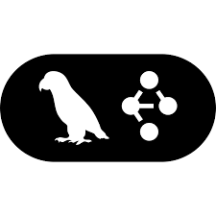
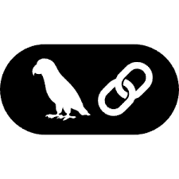


Intelligent Digital Brain on AWS – Scaled Enterprise AI Architecture (L2)
Enterprise-grade brain layers for continuously learning, semantically grounded, agentic execution at scale.
Industry Pattern
Libraries
Employee Copilots
Analyst & Investigator Workbenches
Contact Center Assist
Digital Channels
Back-office Automation
Developer & Ops Productivity
Core Design Principles
Copilot & Workbench Blueprints
Role-based copilots
Investigator workbenches
Process automation playbooks
Domain Agent Libraries
Domain agent templates
Toolkits for process reinvention
Reusable evaluation packs
Solution Delivery & Adoption Kits
Operating model patterns
Controls/evidence packs
Change management + enablement
Industry Apps: Salesforce, Workday, ServiceNow, SAP, Pega/Appian, Guidewire, & more
Evergreen Learning System
Continuous improvement loop operationalized
AI Governance, Registry & Lineage
AI Observability, Monitoring & Evaluation
Responsible, Explainable &
Compliant AI
AI Lifecycle Automation & Promotion
Lifecycle Scope:
Models · Agents · Prompts · Policies · Knowledge · Data · Tools
5
AI Lifecycle
Management
IAM
KMS
SageMaker
Macie
X-Ray
Bedrock Guardrail
Security Hub
Organizations + SCP
Secrets Manager
Code
Pipeline
Code
Catalyst
DynamoDB
CloudTrail
CloudWatch
SageMaker
Bedrock
Code
Build
Clarify
Config
Step Functions
Event
Bridge
Institutional Knowledge Compounding
Captures explicit, implicit, and tacit knowledge
Agent
Orchestration
Agent Framework
Industry Agents
KYC
OPS
Agent Certification & Readiness
4
Agent Ensemble
Lambda
API Gateway
KYC Agents
Ops Agent
Optional:
Salesforce/
ServiceNow/
SAP
connectors
Optional: Arize/
Fiddler, W&B
FRD
MKT
Code
Build
Step
Functions
Code
Pipeline
Bedrock Guardrail
SageMaker Pipelines
Agent
Core
EventBridge
SQS/SNS
Strands
Langgraph
Langchain
Crew AI
Autogen
Bedrock Agents
Fraud Detection
Marketing Agent
Model Recipe
Optional: OpenAI/Anthropic, Hugging Face
Adaptive Learning Loop
Experiential Knowledge Acquisition
Trusted Agentic Execution
Certified agents, evidence packs, policy enforcement, secure tool execution across enterprise systems
3
Specialized Models
Optional: HumanLoop, Great Expectations, Evidently
Optional: Labelbox, Snorkel
SageMaker
SageMaker Model Registry
SageMaker Feature Store
Bedrock Eval Model
SageMaker Pipelines
SageMaker Training Jobs
DynamoDB
Glue
SageMaker
Bedrock
Bedrock Finetune
A2I
S3
Semantic Layer
Knowledge Representation
Domain Ontology Engineering
2
Domain Ontologies
Optional:
Collibra, Alation, Atlan
Optional: Stardog, Neo4j
Optional: TopBraid/
PoolParty tooling
Glue
Lake Formation
OpenSearch
Code
Catalyst
Step Functions
Athena
Neptune
Bedrock Knowledgebase
Reusable Accelerators for Any Domain
Same core brain across industries; plug-in ontologies, data products, agent libraries
Data Accessibility & Ingestion
Data Products & Service Stores
Data Access & Integration Fabric
1
Data Foundation
S3
Glue
Lake Formation
Athena
MSK
Redshift
Aurora
DataZone
Step Functions
Lambda
EKS
Kinesis
DMS
S3
DynamoDB
API Gateway
Brain Infrastructure
Compute
AWS Silicon Options
Networking
Identity & Secrets
Resilience
Org & Isolation
Source Systems, External Systems

Slide 5
AWS Native Coverage vs Gaps + Recommended 3rd-Party Tech Stack (1/2)
L2 Brain (Sub) Layer | Capability | Can Be Fully AWS Native? | Key AWS Native Services | Where AWS Becomes Insufficient | Recommended 3rd-Party / Open Source Stack (Only for Gaps)
Industry Pattern Libraries | Industry workflows, agent templates, reusable playbooks | Partially | Step Functions, Bedrock, Lambda | No vertical “industry cognition” or reusable domain-agent IP | Accenture Industry Agent Libraries; domain packs from SAP/ServiceNow/Salesforce ecosystems; LangGraph template libraries
Copilot & Workbench Blueprints | Role-based copilots, investigator workbenches | Yes (basic) | Amazon Q, Bedrock, API Gateway | Deep domain workbenches, case/investigation UIs, regulated workflows | Palantir-style workbench patterns; Retool / Appsmith (open source) for rapid internal workbenches; custom UX frameworks
AI Governance, Registry & Lineage | Governance, traceability, lineage | Yes (models) Partial (agents) | SageMaker Model Registry, CloudTrail, DynamoDB | Agent decision lineage, “why” trace, evidence packs across multi-agent runs | MLflow (model tracking); OpenLineage; Collibra/Alation (enterprise governance); Arize / Fiddler for decision trace + QA gates
AI Observability & Monitoring | Infra + runtime observability | Yes (infra) Partial (agent quality) | CloudWatch, X-Ray | Hallucination detection, semantic correctness, tool misuse, agent behavior drift | Arize Phoenix (OSS) / Arize; WhyLabs; LangSmith (if using LangChain); OpenTelemetry traces for agent spans
Responsible & Explainable AI | Safety + explainability | Yes (baseline safety) Partial (explainability) | Bedrock Guardrails, IAM, KMS | Explainability for decisions across multi-agent reasoning chains | Fiddler; TruEra; Arize; Evidently (OSS) for drift/explanations
AI Lifecycle Automation & Promotion | CI/CD promotion gates | Yes | CodePipeline, CodeBuild, Step Functions | Advanced release gating tied to eval metrics across agents | Weights & Biases (optional); Arize eval gates; custom “agent certification” framework plugged into CI
Agent Orchestration | Multi-agent coordination | Yes (workflow) Partial (cognitive planning) | Step Functions, EventBridge, EKS | Cognitive planning graphs, dynamic tool routing, reusable agent frameworks | LangGraph; CrewAI; AutoGen (Microsoft OSS); Temporal (workflow engine) if complex long-running orchestration is needed
Industry Agents | Domain-specialized agents | No | N/A | AWS does not provide vertical agents out of box | Accenture Industry Agents; Salesforce Agentforce patterns; ServiceNow agent patterns; SAP Joule extensions; partner domain agent packs
Agent Certification & Readiness | Certify agents before prod | Yes (custom) Partial (productized) | CI/CD stack + S3 evidence store | No out-of-box agent readiness scoring/certification product | Arize / WhyLabs for eval gates; W&B (optional); Great Expectations (data quality); custom certification scorecards
Industry Pattern Libraries
AI Lifecycle Management
Agent Ensemble

Slide 6
AWS Native Coverage vs Gaps + Recommended 3rd-Party Tech Stack (2/2)
L2 Brain (Sub) Layer | Capability | Can Be Fully AWS Native? | Key AWS Native Services | Where AWS Becomes Insufficient | Recommended 3rd-Party / Open Source Stack (Only for Gaps)
Model Recipe | Domain adaptation, fine-tuning | Yes | SageMaker, Bedrock, S3 | Mixing non-AWS models, specialized training stacks | Hugging Face (enterprise); vLLM (open source) for serving where relevant; OpenAI/Anthropic (if multi-provider)
Adaptive Learning Loop | Feedback → improvement loop | Yes (buildable) Partial (productized) | EventBridge, Pipelines, DynamoDB/S3 | Structured human feedback capture, learning analytics, systematic improvement workflows | HumanLoop; Label Studio (OSS); Evidently (OSS); Great Expectations; Arize feedback loops
Experiential Knowledge Acquisition | Capture outcomes + feedback | Yes (basic) Partial (scaled) | DynamoDB, S3, Glue | High-quality labeling, weak supervision, scalable annotation governance | Snorkel; Labelbox; Scale AI (if allowed); Label Studio (OSS)
Semantic Layer | Business meaning abstraction | Yes (data semantics) Partial (enterprise semantic governance) | Glue, Lake Formation, Athena | Semantic governance, stewardship workflows, enterprise semantic contracts | Collibra; Alation; Atlan; OpenMetadata (OSS)
Knowledge Representation | Graph representation | Yes (storage) Partial (advanced reasoning) | Neptune | Complex inference, rules engines, ontology-driven reasoning patterns | Stardog; Neo4j; TerminusDB (OSS)
Domain Ontology Engineering | Ontology authoring + lifecycle | No | N/A | AWS has minimal ontology engineering tools | TopBraid; PoolParty; Protégé (OSS)
Data Accessibility | Secure access to data | Yes | Lake Formation, Glue, Athena, S3 | Generally sufficient | Usually none needed
Data Products | Curated reusable data assets | Yes (buildable) Partial (governance tooling) | Redshift, Aurora, S3 | Data product governance and contracts at enterprise scale | Collibra/Atlan/Alation; OpenMetadata (OSS)
Data Agents | Automated data tasks | Yes (custom) | Lambda, Step Functions, EKS | If you want prebuilt “data agent frameworks” | OSS agent frameworks; Great Expectations for validations; dbt (if applicable)
Brain Infrastructure | Compute, network, security, tenancy | Yes | VPC, IAM, KMS, EKS/ECS, Organizations | No major gaps | Usually none needed
Specialized Models
Domain Ontologies
Data Foundation
Brain Infrastructure

Slide 7
The Banking Digital Brain on AWS: A Runtime Architecture Flow Blueprint (L2)
Banking Source Systems
Core Banking
CRM
KYC
Fraud
Document Repositories
Contact Center
Market Data Feeds
Core Digital Brain on AWS
Banking Data Foundation
Banking Domain Ontologies
Specialized Banking Models
Banking Agent Ensemble
AI Lifecycle Management
Data Accessibility
Semantic Layer
Model Recipe
Agent Orchestration
Governance, Registry & Lineage
S3 (Raw)
Glue
Lake Formation
Glue Data Catalog
Lake Formation
Bedrock
SageMaker
S3
EKS
Step Functions
API Gateway
SageMaker Model Registry
DynamoDB
+ Other AWS Data Services
Context Retrieval
Observability, Monitoring & Evaluation
Knowledge Representation
Adaptive Learning
Kinesis
Redshift
Data Products
Graph Context Retrieval
Sense
Interpret
Evaluate
Learn
OpenSearch
Neptune
CloudWatch
AWS X-Ray
QuickSight
Neptune Graph
Govern
Reflect
Deploy
Agent Certification
Responsible, Explainable, Compliant AI
Customer 360
Risk 360
Domain Ontology Engineering
Experiential Knowledge Acquisition
Step Functions
CodeBuild
Data Agents
Bedrock Guardrails
IAM
KMS
Industry Agents
Lifecycle Automation & Orchestration
Step Functions
EKS
Lambda
Fraud Analyst
Loan Officer
Service Bot
Feedback Loop
Human Expertise
S3
DynamoDB
SageMaker
Customer Analyst
Loan Analyst
Industry Agent
CodePipeline
CodeBuild
Banking Experience Layer
Banker Copilots
Investigator Workbench
Contact Center Assist
Digital Channels
Back-office Automation

Slide 8
Azure

Slide 9
L2

Slide 10





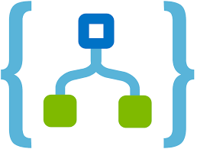










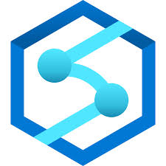
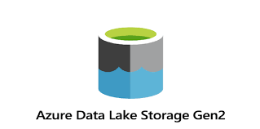


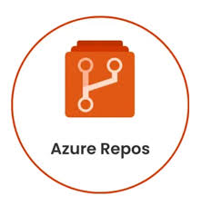
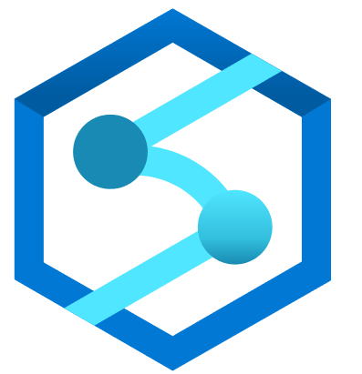
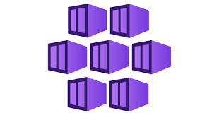

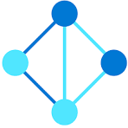
Intelligent Digital Brain on Azure —Agentic Execution Flow (L2)
The brain interaction with external world applications happens through agentic orchestration supported by specialized agents
Marketing Apps
Initiate domain requests through agent-driven orchestration.
Sales Apps
Invoke the Brain for contextual reasoning and next-best actions.
Finance Apps
Support complex decisions with knowledge-grounded intelligence.
1
2
Agents have access to models, tools and knowledge through a set of AI gateways that act as control points
1
Agent Orchestration
Plans, coordinates, executes multi-agent workflows.
3
An ensemble of models that continue to learn are accessed for planning, reasoning and decisioning purposes
AI Governance & Controls
Enforces trust, security, policy compliance.
AI Lifecycle Automation
Promotes models + agents through governed pipelines.
Agent Memory & State
Maintains task context, session state, episodic memory.
Azure Blob
Storage
4
Specialized knowledge is engineered and access through semantic layer for agent consumption. Built from the underlying data products
Azure Open AI Service
AzureKey Vault
Azure
DevOps Pipeline
7
Azure Open AI Service
Azure Logic Apps
Event Grid
Azure Cosmos db
Azure Cache
With Redis
IAM
Azure Pipeline
2
AI Observability
Monitors performance, quality, usage in real time.
Responsible & Explainable AI
Ensures fairness, transparency, regulatory alignment.
Agent actions update data products as where relevant to maintain updated information
LLM Gateway
Provides governed access to foundation + specialized models.
MCP Gateway
Routes models, context, policies through control points.
Agent Gateway
Executes agent actions securely across enterprise systems.
5
Azure
Monitor
Azure Application Insights
Azure Open AI Service
Azure Machine
Learning
6
Orchestrate with enterprise systems providing data products and embedded agents
Azure Open AI Service
Azure API Gateway
Azure
Functions
Azure API Gateway
Azure VNet
3
6
Model Recipe
Transforms general models into domain-specific intelligence.
Model Invocation & Routing
Selects & invokes the right model per task/policy.
4
5
Semantic Layer
Translates data into business concepts/meaning.
Knowledge Representation
Connects entities+ relationships for contextual reasoning.
Data Products
Serve curated, reusable domain data to the Brain.
Enterprise Systems
Provide operational data and agents execute real-world actions.
Azure Open AI Service
Azure Machine
Learning
Azure Blob
Storage
Azure Open AI Service
Azure Machine
Learning
Azure API Gateway
Data Lake Storage Gen2 + Lake formation
Azure Blob
Storage
Azure Synapse
Analytics
Azure Data factory
Azure Cosmos db
Domain Ontology Engineering
Designs and evolves domain knowledge structures.
Data Accessibility
Provides governed access to enterprise data sources.
ERP
SAP
Adaptive Learning Loop
Continuously improves reasoning, decisions, behavior.
Experiential Knowledge Acquisition
Captures outcomes + human feedback to refine intelligence.
Azure Repos
Azure Blob
Storage
Azure Logic Apps
Azure factory
Salesforce
ServiceNow
Azure
Cosmos db
Azure
Storage
Azure factory
Azure Machine
Learning
Human Expertise
Azure Blob
Storage
Serverless pool
Azure
Monitor
Event Grid
Azure
Machine
Learning
Azure Application Insights
7
At every stage of agentic orchestration, relevant governance controls kick in. Visibility logs are captured to track the brain interactions
Cluster & Container Infrastructure
Runs scalable agent & model workloads.
Serverless Infrastructure
Executes event-driven + on-demand logic.
Multi-Tenancy
Isolates domains, teams, environments securely.
AKS
ACI
Azure
Functions
Azure
Management Groups
Notes:
Higher level slide version of this is in Appendix – slide 11

Slide 11











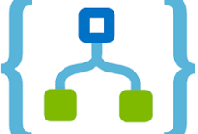
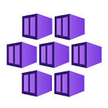





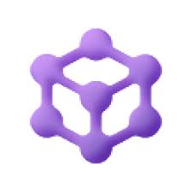



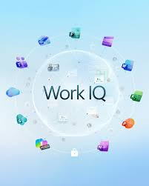


Intelligent Digital Brain on Azure – Scaled Enterprise AI Architecture (L2)
Enterprise-grade brain layers for continuously learning, semantically grounded, agentic execution at scale.
Industry Pattern
Libraries
Employee Copilots
Analyst & Investigator Workbenches
Contact Center Assist
Digital Channels
Back-office Automation
Developer & Ops Productivity
Core Design Principles
Copilot & Workbench Blueprints
Role-based copilots
Investigator workbenches
Process automation playbooks
Domain Agent Libraries
Domain agent templates
Toolkits for process reinvention
Reusable evaluation packs
Solution Delivery & Adoption Kits
Operating model patterns
Controls/evidence packs
Change management + enablement
Industry Apps: Salesforce, Workday, ServiceNow, SAP, Pega/Appian, Guidewire, & more
Evergreen Learning System
Continuous improvement loop operationalized
AI Governance, Registry & Lineage
AI Observability, Monitoring & Evaluation
Responsible, Explainable & Compliant AI
AI Lifecycle Automation & Promotion
Lifecycle Scope:
Models · Agents · Prompts · Policies · Knowledge · Data · Tools
5
AI Lifecycle
Management
Azure ML
Azure
CosmosDB
Azure Activity Logs
Azure Monitor
App
sights
Azure ML
Azure OpenAI
Azure OpenAI
Microsoft
EntraID
Azure
Key Vault
Azure devOps
Pipeline
Auzre
Pipelines
Azure Log Apps
Institutional Knowledge Compounding
Captures explicit, implicit, and tacit knowledge
Agent Orchestration
Industry Agents
Agent Certification & Readiness
4
Agent Ensemble
AKS
Azure
Logic Apps
ACI
Azure
Event Grid
AKS
Azure
Functions
Azure
CosmosDB
Azure
Cognitive
Search
Microsoft Agent framework
Azure
DevOps Pipeline
Azure Log Apps
Azure Blob
Storage
Model Recipe
Adaptive Learning Loop
Experiential Knowledge Acquisition
Trusted Agentic Execution
Certified agents, evidence packs, policy enforcement, secure tool execution across enterprise systems
3
Specialized Models
Azure OpenAI
Azure Machine Learning
Azure Blob
Storage
Azure
Monitor
Azure
Application Insights
Event
Grid
Azure Machine Learning
Azure
CosmosDB
Azure
Storage
Azure
Factory
Azure Machine Learning
Semantic Layer
Knowledge Representation
Domain Ontology Engineering
2
Domain Ontologies
Data Lake Storage
Gen2 + Lake formation
Azure factory
Microsoft
Purview
Work IQ
Azure
CosmosDB
Azure Blob
Storage
Azure Logic Apps
Foundary IQ
Human Expertise
Azure Repos
Reusable Platform for Any Domain
Same core brain across industries; plug-in ontologies, data products, agent libraries
Data Accessibility
Data Products
Data Agents
1
Data Foundation
AzureBlob
Storage
Azure factory
Serverless pool
Azure Blob
Storage
Azure Synapse
Analytics
Foundary IQ
Microsoft
Fabric OneLake
Microsoft
Purview
Brain Infrastructure
Compute
AWS Silicon Options
Networking
Identity & Secrets
Resilience
Org & Isolation
Source Systems, External Systems

Slide 12
Azure Native Coverage vs Gaps + Recommended 3rd-Party Tech Stack (1/2)
L2 Brain (Sub) Layer | Capability | Can Be Fully Azure Native? | Key Azure Native Services | Where Azure Becomes Insufficient | Recommended 3rd-Party / Open Source Stack (Only for Gaps)
Industry Pattern Libraries | Industry workflows, agent templates, reusable playbooks | Partially | Microsoft Foundry, Azure AI Studio, Semantic Kernel | Limited vertical industry-specific cognition; lacks deep sector customization out-of-box | Accenture Industry Agent Libraries; domain packs from SAP/ServiceNow/Salesforce ecosystems; LangGraph template libraries; AutoGen (OSS, integrated but extensible)
Copilot & Workbench Blueprints | Role-based copilots, investigator workbenches | Yes (basic) | Azure Copilot, Microsoft Foundry, Azure AI Studio | Deep domain-specific workbenches for regulated/investigative Uis; advanced case management workflows require custom builds | Palantir-style workbench patterns; Retool / Appsmith (open source); custom UX frameworks via Visual Studio integration
AI Governance, Registry & Lineage | Governance, traceability, lineage | Yes (models) Partial (agents) | Microsoft Foundry (governance and evaluations), Azure AI Model registry, Azure Purview for lineage | Comprehensive agent decision traceability across multi-agent runs; evidence packs for complex chains | MLflow (model tracking); OpenLineage; Collibra/Alation; Arize/Fiddler for agent-specific QA gates
AI Observability & Monitoring | Infra + runtime observability | Yes (infra) Partial (agent quality) | Microsoft Foundry observability, Azure Monitor, Application Insights | Advanced hallucination detection, semantic drift, agent behavior monitoring in production; tool misuse analytics | Arize Phoenix (OSS) / Arize; WhyLabs; LangSmith (if using LangChain); OpenTelemetry traces; New Relic integrations for Azure-specific agent monitoring
Responsible & Explainable AI | Safety + explainability | Yes (baseline safety) Partial (explainability) | Microsoft Foundry safety filters, Azure Content Safety, Responsible AI Toolbox | Multi-agent reasoning chain explainability; end-to-end decision transparency in dynamic systems | Fiddler; TruEra; Arize; Evidently (OSS) for drift/explanations
AI Lifecycle Automation & Promotion | CI/CD promotion gates | Yes | Azure DevOps, Azure Pipelines, Microsoft Foundry for scaling from POC to production | Advanced eval-metric tied getting for agents; automated promotion in multi-agent setups | Weights & Biases; Arize for eval gates; custom frameworks plugged into Azure CI/CD
Agent Orchestration | Multi-agent coordination | Yes | Microsoft Agent Framework (SDK for orchestration), Microsoft Foundry workflows, Semantic Kernel/AutoGen convergence | Cognitive planning for highly dynamic, reusable frameworks; complex long-running orchestration beyond basics | LangGraph; CrewAI; AutoGen (Microsoft OSS); Temporal (OSS for workflows); AutoGen extensions
Industry Agents | Domain-specialized agents | Partially | Azure Copilot agents (e.g; migration, organization), Microsoft Foundry for custom agents | No comprehensive out-of-box vertical agents; requires building or integration for domains like finance/healthcare | Accenture/Salesforce Agentforce; ServiceNow agents; partner packs via Microsoft Foundry integrations
Agent Certification & Readiness | Certify agents before prod | Yes (custom) Partial (productized) | Microsoft Foundry evaluations, Azure AI Red Teaming Agent, CI/CD stacks | Out-of-box readiness scoring/certification; automated certification products for agents | Arize / WhyLabs for eval gates; custom scorecards in Azure DevOps
Industry Pattern Libraries
AI Lifecycle Management
Agent Ensemble

Slide 13
Azure Native Coverage vs Gaps + Recommended 3rd-Party Tech Stack (2/2)
L2 Brain (Sub) Layer | Capability | Can Be Fully Azure Native? | Key Azure Native Services | Where Azure Becomes Insufficient | Recommended 3rd-Party / Open Source Stack (Only for Gaps)
Model Recipe | Domain adaptation, fine-tuning | Yes | Azure Machine Learning, Microsoft Foundry model customization, Azure OpenAI fine-tuning | Mixing non-Azure models in hybrid stacks, specialized training for edge cases | Hugging Face (enterprise); vLLM (open source) for serving; Anthropic/OpenAI if multi=provider needed
Adaptive Learning Loop | Feedback → improvement loop | Yes (buildable) Partial (productized) | Microsoft Foundry feedback mechanism, Azure AI evaluations, Event Hubs | Structured capture and analytics for agent learning; systematic workflows beyond basics | HumanLoop; Label Studio (OSS); Evidently (OSS); Ariza for loops
Experiential Knowledge Acquisition | Capture outcomes + feedback | Yes (basic) Partial (scaled) | Microsoft Foundry memory/knowledge integration, Azure Cosmos DB | High-quality scalable annotation governance; weak supervision in large-scale agent systems | Scale AI/Labelbox; Label Studio (OSS)
Semantic Layer | Business meaning abstraction | Yes (data) Partial (enterprise) | Azure Synapse, Microsoft Foundry IQ for grounding | Enterprise semantic contracts and stewardship workflows | Collibra; Alation; Atlan; OpenMetadata (OSS)
Knowledge Representation | Graph representation | Yes (storage) Partial (advanced) | Azure Cosmos DB (Gremlin), Microsoft Foundry knowledge bases | Ontology-driven reasoning patterns; complex inference engines | Stardog;/Neo4j; TerminusDB (OSS)
Domain Ontology Engineering | Ontology authoring + lifecycle | No | N/A | Minimal native ontology tools; requires third-party for authoring/lifecycle | TopBraid; PoolParty; Protégé (OSS)
Data Accessibility | Secure access to data | Yes | Azure Data Lake, Azure AD IAM, Microsoft Foundry security | Generally sufficient; no major gaps in core access | Usually none needed
Data Products | Curated reusable data assets | Yes (buildable) Partial (governance tooling) | Azure Data Factory, Microsoft Purview | Enterprise-scale governance/contracts for data products | Collibra/Atlan/Alation; OpenMetadata (OSS)
Data Agents | Automated data tasks | Yes (custom) | Azure Functions, Microsoft Foundry tools/connectors, Data Factory | Prebuilt data agent frameworks beyond custom builds | OSS agent frameworks (e.g; LangChain); Great Expectations for validations; dbt
Brain Infrastructure | Compute, network, security, tenancy | Yes | Azure Virtual Network, Azure AD, AKS/ACI, Azure organizations | No major gaps; agent IAM emerging but sufficient for most | Usually none needed; MCP (OSS protocol) for advanced integrations
Specialized Models
Domain Ontologies
Data Foundation
Brain Infrastructure

Slide 14
GCP

Slide 15
L2

Slide 16
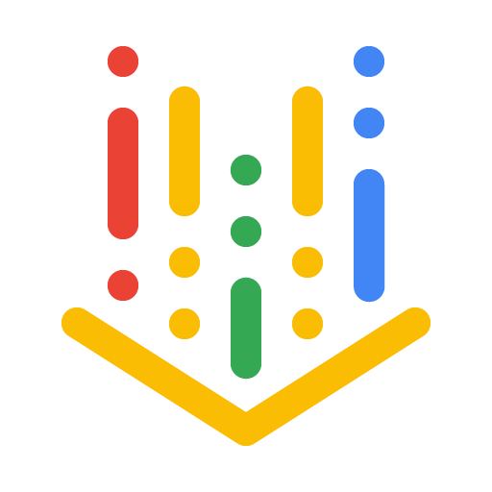


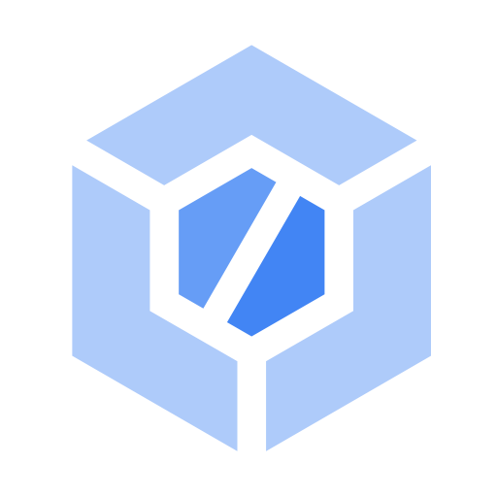
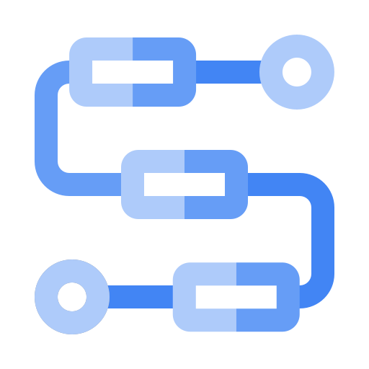



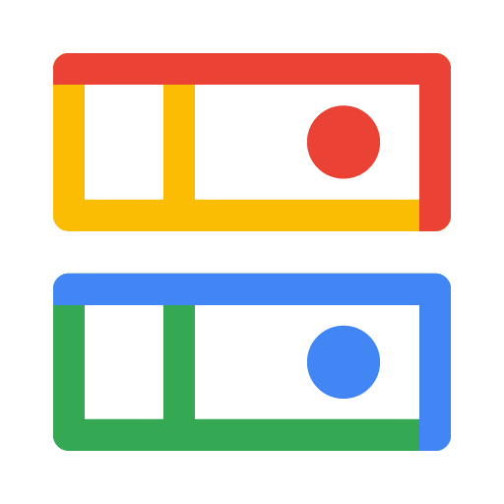









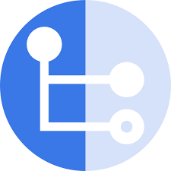
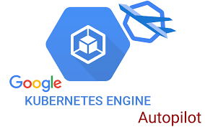
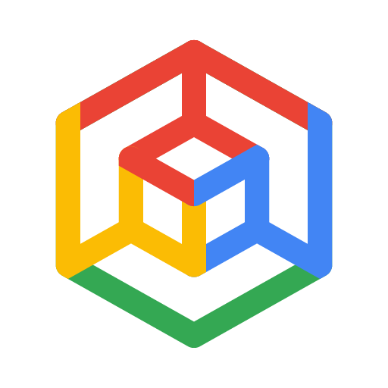


Intelligent Digital Brain on Google Cloud —Agentic Execution Flow (L2)
The brain interaction with external world applications happens through agentic orchestration supported by specialized agents
Marketing Apps
Initiate domain requests through agent-driven orchestration.
Sales Apps
Invoke the Brain for contextual reasoning and next-best actions.
Finance Apps
Support complex decisions with knowledge-grounded intelligence.
1
2
Agents have access to models, tools and knowledge through a set of AI gateways that act as control points
1
Agent Orchestration
Plans, coordinates, executes multi-agent workflows.
3
An ensemble of models that continue to learn are accessed for planning, reasoning and decisioning purposes
AI Governance & Controls
Enforces trust, security, policy compliance.
AI Lifecycle Automation
Promotes models + agents through governed pipelines.
Agent Memory & State
Maintains task context, session state, episodic memory.
Cloud Storage
4
Specialized knowledge is engineered and access through semantic layer for agent consumption. Built from the underlying data products
Vertex AI
IAM
Secrets Manager
Cloud Build
7
Vertex AI
Workflows
Eventrac
Firestore
Memory Store w/ Redis
AI Observability
Monitors performance, quality, usage in real time.
Responsible & Explainable AI
Ensures fairness, transparency, regulatory alignment.
2
LLM Gateway
Provides governed access to foundation + specialized models.
MCP Gateway
Routes models, context, policies through control points.
Agent Gateway
Executes agent actions securely across enterprise systems.
5
Agent actions update data products as where relevant to maintain updated information
Vertex AI
Monitor
Cloud Trace
Vertex AI
6
Orchestrate with enterprise systems providing data products and embedded agents
Apigee
Cloud Functions
Apigee
VPC
3
6
Model Recipe
Transforms general models into domain-specific intelligence.
Model Invocation & Routing
Selects & invokes the right model per task/policy.
4
5
Semantic Layer
Translates data into business concepts/meaning.
Knowledge Representation
Connects entities+ relationships for contextual reasoning.
Data Products
Serve curated, reusable domain data to the Brain.
Enterprise Systems
Provide operational data and agents execute real-world actions.
Vertex AI
Cloud Storage
Vertex AI
Apigee
Cloud Storage
Data Fusion
Firestore
Cloud Storage
BigQuery
Adaptive Learning Loop
Continuously improves reasoning, decisions, behavior.
Experiential Knowledge Acquisition
Captures outcomes + human feedback to refine intelligence.
Domain Ontology Engineering
Designs and evolves domain knowledge structures.
Data Accessibility
Provides governed access to enterprise data sources.
ERP
SAP
Cloud Source Repositories
Cloud Storage
Workflows
Cloud Storage
Salesforce
ServiceNow
Monitor
Cloud
Operation
Eventrac
Vertex AI
Firestore
Cloud Storage
Data Fusion
Vertex AI
Human Expertise
Data Fusion
GKE Autopilot
7
At every stage of agentic orchestration, relevant governance controls kick in. Visibility logs are captured to track the brain interactions
Cluster & Container Infrastructure
Runs scalable agent & model workloads.
Serverless Infrastructure
Executes event-driven + on-demand logic.
Multi-Tenancy
Isolates domains, teams, environments securely.
GKE
ACI
Cloud Functions
Google Cloud Folder
Notes:
Higher level slide version of this is in Appendix – slide 11

Slide 17




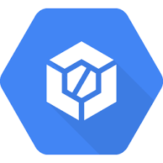
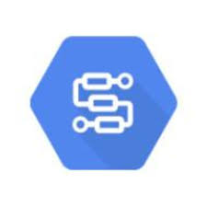

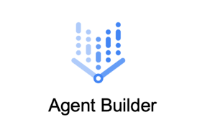
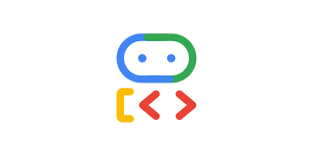
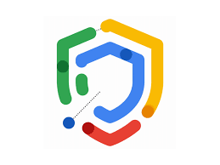



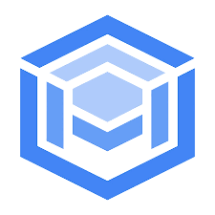
Intelligent Digital Brain on Google Cloud – Scaled Enterprise AI Architecture (L2)
Enterprise-grade brain layers for continuously learning, semantically grounded, agentic execution at scale.
Industry Pattern
Libraries
Employee Copilots
Analyst & Investigator Workbenches
Contact Center Assist
Digital Channels
Back-office Automation
Developer & Ops Productivity
Core Design Principles
Copilot & Workbench Blueprints
Role-based copilots
Investigator workbenches
Process automation playbooks
Domain Agent Libraries
Domain agent templates
Toolkits for process reinvention
Reusable evaluation packs
Solution Delivery & Adoption Kits
Operating model patterns
Controls/evidence packs
Change management + enablement
Industry Apps: Salesforce, Workday, ServiceNow, SAP, Pega/Appian, Guidewire, & more
Evergreen Learning System
Continuous improvement loop operationalized
AI Governance, Registry & Lineage
AI Observability, Monitoring & Evaluation
Responsible, Explainable & Compliant AI
AI Lifecycle Automation & Promotion
Lifecycle Scope:
Models · Agents · Prompts · Policies · Knowledge · Data · Tools
5
AI Lifecycle
Management
Vertex AI
Google Cloud IAM
Google
Cloud Secrets Manager
Google
Monitor
Google
Cloud Trace
Vertex AI
GoogleCloud
Build
Institutional Knowledge Compounding
Captures explicit, implicit, and tacit knowledge
Agent Orchestration
Industry Agents
Agent Certification & Readiness
4
Agent Ensemble
Vertex AI
Google Cloud
Workflows
Google Eventrac
Agent Dev Kit
Gemini Enterprise
Agent Dev Kit
Model Recipe
Adaptive Learning Loop
Experiential Knowledge Acquisition
Trusted Agentic Execution
Certified agents, evidence packs, policy enforcement, secure tool execution across enterprise systems
3
Specialized Models
Vertex AI
Google CLoud
Storage
Google
Monitor
Google Cloud
Operation
Google
Eventrac
Vertex AI
Google
Firestore
Google Cloud
Storage
Google Data
Fusion
Vertex AI
Semantic Layer
Knowledge Representation
Domain Ontology Engineering
2
Domain Ontologies
Google
Cloud Storage
Google
Data Fusion
Google FIrestore
Cloud Source
Repositories
Google Cloud
Storage
Google Cloud
Workflows
Human Expertise
Reusable Platform for Any Domain
Same core brain across industries; plug-in ontologies, data products, agent libraries
Data Accessibility
Data Products
Data Agents
1
Data Foundation
GoogleCloud
Storage
Google Data Fusion
GKE Autopilot
Google Cloud
Storage
Google Big Query
Google
Big Query
Alloy DB
Brain Infrastructure
Compute
AWS Silicon Options
Networking
Identity & Secrets
Resilience
Org & Isolation
Source Systems, External Systems

Slide 18
Google Cloud Native Coverage vs Gaps + Recommended 3rd-Party Tech Stack (1/2)
L2 Brain (Sub) Layer | Capability | Can Be Fully Google Cloud Native? | Key Google Cloud Native Services | Where Google Cloud Becomes Insufficient | Recommended 3rd-Party / Open Source Stack (Only for Gaps)
Industry Pattern Libraries | Industry workflows, agent templates, reusable playbooks | Partially | Vertex AI, Agent Builder, Agent Development Kit (ADK), Vertex AI Studio | Limited vertical cognition or domain-specific agent IP; focuses on general templates | Accenture libraries; SAP/ServiceNow/Salesforce packs; LangGraph (OSS) templates
Copilot & Workbench Blueprints | Role-based copilots, investigator workbenches | Yes (basic) | Vertex AI Studio, Gemini integration, Conversational Agents | Deep regulated Uis/workbenches; advanced investigative flows require customization | Palantir patterns; Retool/Appsmith (OSS); custom UX via google Cloud tools
AI Governance, Registry & Lineage | Governance, traceability, lineage | Yes (models) Partial (agents) | Vertex AI Model Registry, Gen AI Evaluation Service, Data Lineage in BigQuery | Agent-specific decision traces across multi-agent; comprehensive evidence packs | MLflow ((OSS); OpenLineage; Collibra/Alation; Ariza for QA
AI Observability & Monitoring | Infra + runtime observability | Yes (infra) Partial (agent quality) | Vertex AI Model Monitoring, Cloud Monitoring, Agentic SOC | Semantic drift/hallucination in agents; behavior analytics for complex systems | Arize Phoenix (OSS); WhyLabs; Langsmith; OpenTelemetry
Responsible & Explainable AI | Safety + explainability | Yes (baseline safety) Partial (explainability) | Vertex AI safety filters, Responsible AI practices | Multi-chain explainability in agentic workflows | Fiddler/TruEra; Ariza; Evindently (OSS)
AI Lifecycle Automation & Promotion | CI/CD promotion gates | Yes | Vertex AI Pipelines, Cloud Build, Vertex AI ML Ops | Agent-specific eval gating; advanced promotion for multi-agents | Weights & Biases; Arize gates; custom in Cloud CI/CD
Agent Orchestration | Multi-agent coordination | Yes | Vertex AI Agent Builder Orchestration, ADK, Vertex AI Pipelines | Dynamic cognitive planning reusable frameworks for complex routing | LangGraph; CrewAI (OSS); Temporal; AutoGen
Industry Agents | Domain-specialized agents | Partially | Vertex AI agents (e.g; for retail/CPG, security via Agentic SOC) | Limited out-of-box verticals; needs building for specific domains | Salesforce Agentforce; ServiceNow; partner integrations via A2A protocols
Agent Certification & Readiness | Certify agents before prod | Yes (custom) Partial (productized) | Vertex AI evaluations, CI/CD stacks | Native readiness scoring/certification for agents | Ariza/WhyLabs; Great Expectations (OSS); custom scorecards
Industry Pattern Libraries
AI Lifecycle Management
Agent Ensemble

Slide 19
Google Cloud Native Coverage vs Gaps + Recommended 3rd-Party Tech Stack (2/2)
L2 Brain (Sub) Layer | Capability | Can Be Fully Google Cloud Native? | Key Google Cloud Native Services | Where Google Cloud Becomes Insufficient | Recommended 3rd-Party / Open Source Stack (Only for Gaps)
Model Recipe | Domain adaptation, fine-tuning | Yes | Vertex AI fine-tuning, Model Garden, Gemini models | Hybrid model mixing; specialized stacks for non-Google models | Hugging Face; vLLM (open source); multi-provider via A2A/MCP
Adaptive Learning Loop | Feedback → improvement loop | Yes (buildable) Partial (productized) | Vertex AI feedback tools, pipelines | Advanced agent learning analytics; structured workflows | HumanLoop; Label Studio (OSS); Evidently (OSS)
Experiential Knowledge Acquisition | Capture outcomes + feedback | Yes (basic) Partial (scaled) | Vertex AI Studio, BigQuery for storage | Scalable governance for annotations in agents | Scale AI/Labelbox; Label Studio (OSS)
Semantic Layer | Business meaning abstraction | Yes (data) Partial (enterprise) | BigQuery, AlloyDB, Dataform | Enterprise semantic stewardship/contracts | Collibra; Alation; Atlan; OpenMetadata (OSS)
Knowledge Representation | Graph representation | Yes (storage) Partial (advanced reasoning) | BigQuery (graphs), Spanner | Advanced ontology inference/rules | Stardog; Neo4j; TerminusDB (OSS)
Domain Ontology Engineering | Ontology authoring + lifecycle | No | N/A | Limited native ontology tools | TopBraid; PoolParty; Protégé (OSS)
Data Accessibility | Secure access to data | Yes | BigQuery IAM, AlloyDB, Cloud IAM | Generally sufficient | Usually none needed
Data Products | Curated reusable data assets | Yes (buildable) Partial (governance tooling) | Dataform, BigQuery, Feature Store | Enterprise governance at scale | Collibra/Atlan/Alation; OpenMetadata (OSS)
Data Agents | Automated data tasks | Yes (custom) | Cloud Functions, Vertex AI agents for data | Prebuilt frameworks for data agents | OSS agents (LangChain); Great Expectations (OSS); dbt
Brain Infrastructure | Compute, network, security, tenancy | Yes | VPC, Cloud, IAM, GKE/GCE, Organizations | No major gaps; agentic IAM via A2A | Usually none needed; MCP/A2A (OSS Protocols)
Specialized Models
Domain Ontologies
Data Foundation
Brain Infrastructure

Slide 20
IDB OpenAI Integration Architecture

Slide 21

Intelligent Digital Brain —OpenAI + AWS Execution Flow
1
1
Detect Life-Event Signals: A customer, retail associate, or care agent engages via app, web, store, or contact center.
App and Web
Contact Center Assist
OpenAI models interpret customer intent and conversational context
Activate Ontology & Retrieve Context: The relevant life-event ontology activates; the system retrieves offer, partner, policy, eligibility, and context using graph queries + OpenSearch retrieval
2
Retail Associate Experience
Conversational Commerce Entry
3
Perform Cognitive Reasoning & Planning: An ensemble of agents are activated for planning, reasoning and decisioning. Orchestrator coordinates worker agents via handoffs
API Gateway
Lambda
2
4
Specialized knowledge is engineered and access through semantic layer for agent consumption. Built from the underlying data products
AI Governance & Controls
AI Lifecycle Automation
Agent Orchestration
Agent Memory & State
5
Assemble Agent-Consumable Knowledge from Data Products
Secrets Manager
IAM
KMS
Versioned prompts & agent specs
OpenAI models for planning, task decomposition, reasoning
OpenAI consumes memory context for reasoning
DynamoDB
6
Orchestrate Secure Enterprise System Execution
ElastiCache
7
S3
AI Observability
Responsible & Explainable AI
7
Enforce Governance, Observability & Learning At every stage of agentic orchestration, relevant governance controls kick in.
3
Agent run/tool-call metadata captured
Safety + reasoning outputs governed by AWS policies
LLM Gateway
MCP Gateway
Agent Gateway
Commerce Execution
CloudWatch
X-Ray
API
Gateway
Step Functions
OpenAI models invoked here
Tool schemas + invocation semantics used by OpenAI Agents
Agentic Commerce Protocol used by OpenAI agents to: Discover offers, build cart, execute checkout, confirm orders
API Gateway
Lambda
API
Gateway
Lambda
IAM
API Gateway
PrivateLink/VPC
Lambda
DynamoDB
4
6
Model Recipe
Model Invocation & Routing
Semantic Layer
Knowledge Representation
Data Products
Enterprise Systems
OpenAI models as primary reasoning/ conversational engines. Structured tool calling /decision outputs
Model selection across OpenAI endpoints based on task type
Uses semantic mappings to ground reasoning + explanations
Glue
Neptune
Accessed only through retrieval/ tool interfaces
S3
Redshift
API
Gateway
Lambda
Consumes graph/ semantic retrieval results for context-aware reasoning
Lake Formation
Open
Search
API Gateway
Aurora
Commerce Platforms
Order Management
Network/ Service Systems
Adaptive Learning Loop
Experiential Knowledge Acquisition
5
Data Accessibility
Domain Ontology Engineering
CRM
Billing
Behavior refined via updated prompts, policies, agent workflows.
Summarization & insight extraction over outcomes.
Assists ontology drafting and rule extraction with human approval
S3
Glue
Lake Formation
Athena
Event
Bridge
Step
Functions
Cloud
Watch
S3
Glue
DynamoDB
CodeCommit
S3
Step Functions
Cluster & Container Infrastructure
Runs scalable agent & model workloads.
Serverless Infrastructure
Executes event-driven + on-demand logic.
Multi-Tenancy
Isolates domains, teams, environments securely.
EKS
Lambda
Organizations/Control Tower

Slide 22
Example Customer Journey : Agentic Commerce
A post-move service issue is resolved through agent reasoning, real-time journey context, and standardized commerce execution, with OpenAI providing cognition and AWS providing the governed Digital Brain.
Customer App
Digital Brain / OpenAI Agents (ADK)
Brain Core
Systems / Partners
``
1
``
2
``
Trigger
Intent + Context Reasoning
3
``
Journey Context Retrieval
“My internet keeps dropping since I moved”
OpenAI model parses input
Life Event = Move
Current Stage = Setup
Install date, address, products
Steps 1–2: Signal Ingestion
Steps 3–4: Decisioning
(Agent Reasoning)
Steps 5–7: Action & Execution
Step 9: Learning & Memory
Intent: service degradation
Temporal cue: “since I moved”
Graph DB
Agent infers this is post-move lifecycle context, not generic tech support
Recent network telemetry
Install notes
Similar mover patterns in same geo
4
OpenSearch
AI-native Decisioning
Agent reasoning combines:
Graph context (recent move)
Real-time signals (Wi-Fi drops)
Similar journeys (mesh extender resolved issue)
Concludes: Likely home layout / router placement issue, not network outage
5
6
7
Resolution Plan Created
Policy-Gated Commerce Execution
Merchant + Payment Handling
Agent Orchestrator decomposes plan into policy-checked actions :
Recommend mesh Wi-Fi extender
No escalation to human agent
Plan is policy-checked, not executed yet
Agent calls Agentic Commerce Protocol
Item: Mesh Wi-Fi Extender
Price: $X (promo)
Fulfillment: ship to new address
Inventory & eligibility validated
Billing system applies credit
Fulfillment scheduled
No raw payment data exposed to agent
ACP ensures idempotency, audit trail and secure execution
8
Customer Confirmation
9
“We’re sending you a free Wi-Fi extender and applying a credit to your next bill. ”
Learning + Memory Update
Resolution linked to Move → Setup
Outcome recorded
Graph DB
Index updated for future similarity matching
OpenSearch

Slide 23
Databricks

Slide 24

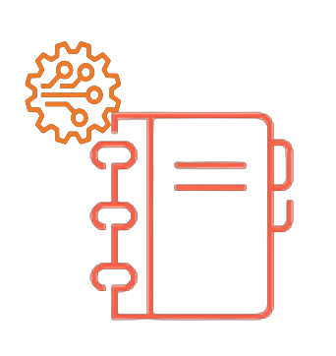
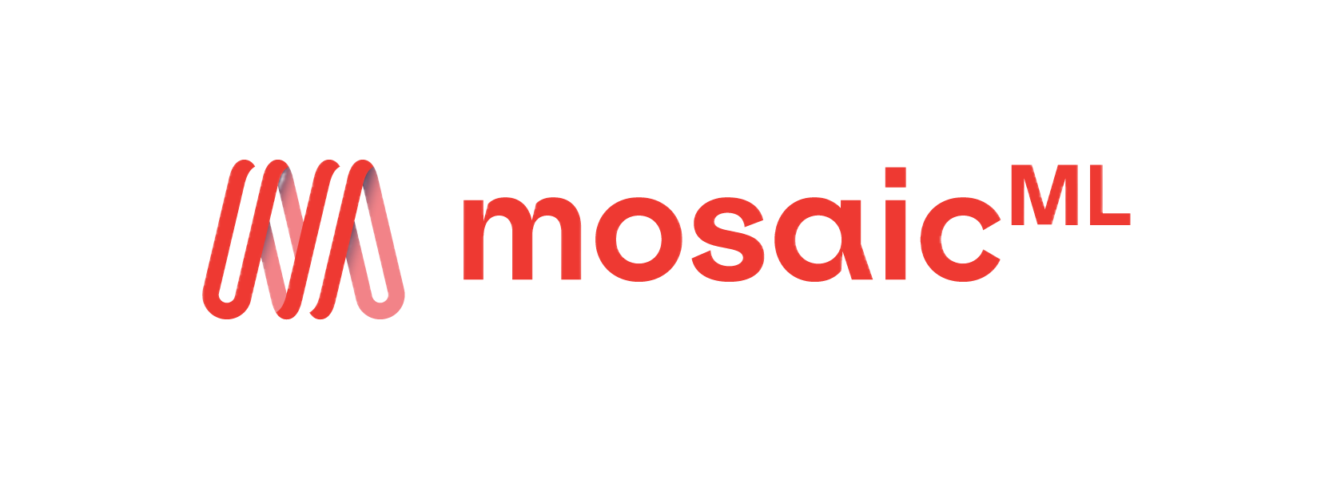




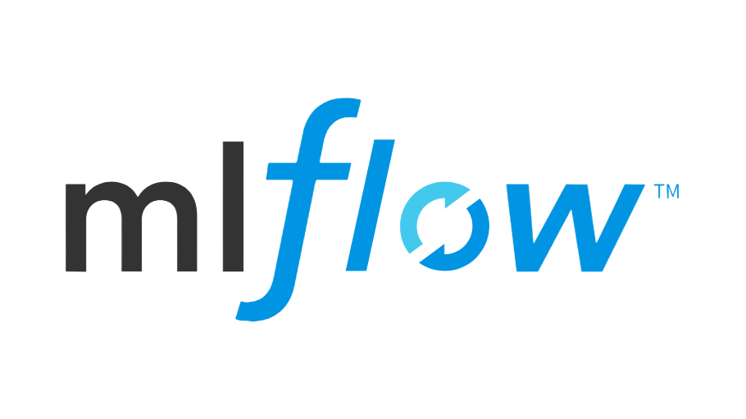




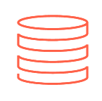


Intelligent Digital Brain on Databricks —Agentic Execution Flow (L2)
The brain interaction with external world applications happens through agentic orchestration supported by specialized agents
Marketing Apps
Initiate domain requests through agent-driven orchestration.
Sales Apps
Invoke the Brain for contextual reasoning and next-best actions.
Finance Apps
Support complex decisions with knowledge-grounded intelligence.
1
2
Agents have access to models, tools and knowledge through a set of AI gateways that act as control points
1
Agent Orchestration
Plans, coordinates, executes multi-agent workflows.
3
An ensemble of models that continue to learn are accessed for planning, reasoning and decisioning purposes
AI Governance & Controls
Enforces trust, security, policy compliance.
AI Lifecycle Automation
Promotes models + agents through governed pipelines.
Agent Memory & State
Maintains task context, session state, episodic memory.
Mosaic AI
Mosaic AI Agent Framework
Delta Lake
Delta Cache
4
Specialized knowledge is engineered and access through semantic layer for agent consumption. Built from the underlying data products
Mosaic AI
Policy
DB Secrets
Github
DAB
7
2
AI Observability
Monitors performance, quality, usage in real time.
Responsible & Explainable AI
Ensures fairness, transparency, regulatory alignment.
Agent actions update data products as where relevant to maintain updated information
Mosaic AI
LLM Gateway
Provides governed access to foundation + specialized models.
MCP Gateway
Routes models, context, policies through control points.
Agent Gateway
Executes agent actions securely across enterprise systems.
5
MLFlow
Unity Catalog
DASF
Workspace
6
Orchestrate with enterprise systems providing data products and embedded agents
AI Gateway
MCP Service
Workflow
Mosaic AI
3
4
5
6
Model Recipe
Transforms general models into domain-specific intelligence.
Model Invocation & Routing
Selects & invokes the right model per task/policy.
Semantic Layer
Translates data into business concepts/ meaning.
Knowledge Representation
Connects entities+ relationships for contextual reasoning.
Data Products
Serve curated, reusable domain data to the Brain.
Enterprise Systems
Provide operational data and agents execute real-world actions.
Mosaic AI
Workspace
Delta Lake
Mosaic AI
Workspace
AI Gateway
Unity Catalog
Delta Lake
Databricks Share
Databricks Marketplace
Domain Ontology Engineering
Designs and evolves domain knowledge structures.
ERP
SAP
Adaptive Learning Loop
Continuously improves reasoning, decisions, behavior.
Experiential Knowledge Acquisition
Captures outcomes + human feedback to refine intelligence.
Data Accessibility
Provides governed access to enterprise data sources.
Github
Delta Lake
Workflow
Human Expertise
Delta Lake
Unity Catalog
Databricks SQL
Salesforce
ServiceNow
Unity Catalog
Workspace
Delta Lake
Unity Catalog
Workspace
Cluster & Container Infrastructure
Runs scalable agent & model workloads.
Serverless Infrastructure
Executes event-driven + on-demand logic.
Multi-Tenancy
Isolates domains, teams, environments securely.
7
At every stage of agentic orchestration, relevant governance controls kick in. Visibility logs are captured to track the brain interactions
Cluster
Serverless
Workflow
Unity Catalog
Notes:
Higher level slide version of this is in Appendix – slide 11

Slide 25
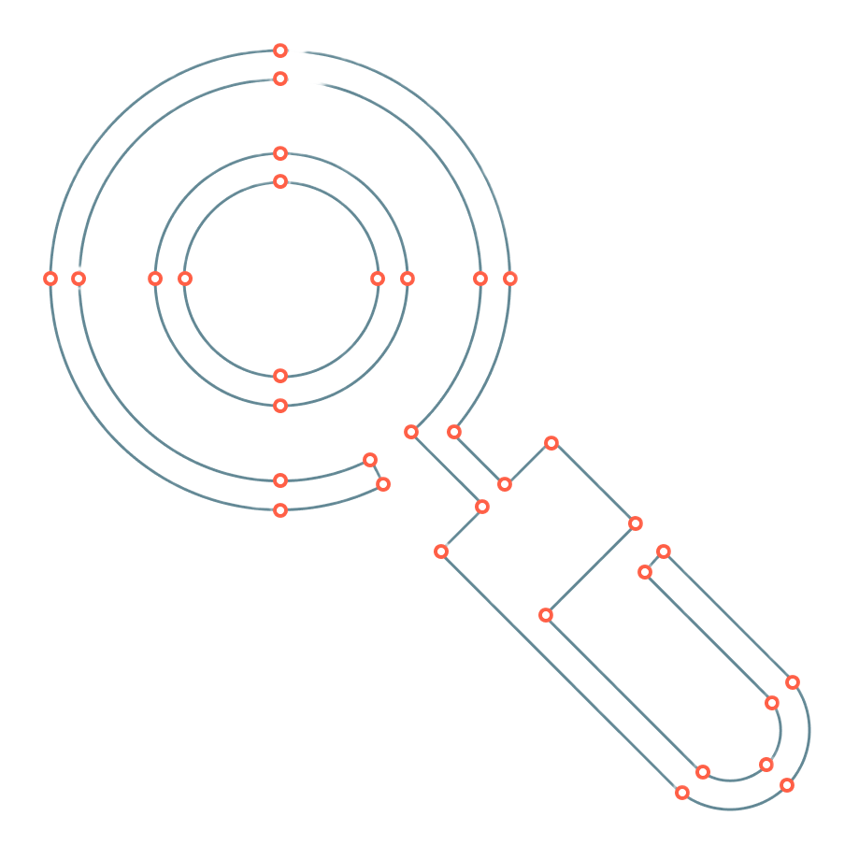

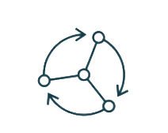
Intelligent Digital Brain on Databricks – Scaled Enterprise AI Architecture (L2)
Enterprise-grade brain layers for continuously learning, semantically grounded, agentic execution at scale.
Industry Pattern
Libraries
Employee Copilots
Analyst & Investigator Workbenches
Contact Center Assist
Digital Channels
Back-office Automation
Developer & Ops Productivity
Core Design Principles
Copilot & Workbench Blueprints
Role-based copilots
Investigator workbenches
Process automation playbooks
Domain Agent Libraries
Domain agent templates
Toolkits for process reinvention
Reusable evaluation packs
Solution Delivery & Adoption Kits
Operating model patterns
Controls/evidence packs
Change management + enablement
Industry Apps: Salesforce, Workday, ServiceNow, SAP, Pega/Appian, Guidewire, & more
Evergreen Learning System
Continuous improvement loop operationalized
AI Governance, Registry & Lineage
AI Observability, Monitoring & Evaluation
Responsible, Explainable & Compliant AI
AI Lifecycle Automation & Promotion
Lifecycle Scope:
Models · Agents · Prompts · Policies · Knowledge · Data · Tools
5
AI Lifecycle
Management
MLFlow
Delta Lake
Unity Catalog
Unity Catalog
MLFlow
Mosaic AI
Mosaic AI
Policy
Databricks Secret
DAB
Workflows
Institutional Knowledge Compounding
Captures explicit, implicit, and tacit knowledge
Agent Orchestration
Industry Agents
Optional:
LangGraph · Salesforce/
ServiceNow/SAP connectors
Agent Certification & Readiness
4
Agent Ensemble
Optional: LangGraph
Optional: Arize/
Fiddler, W&B
Cluster
Workflows
Serverless
Mosaic AI
Unity Catalog
Workflow
Vector Search
Mosaic AI
Workflows
Delta Lake
Model Recipe
Adaptive Learning Loop
Experiential Knowledge Acquisition
Trusted Agentic Execution
Certified agents, evidence packs, policy enforcement, secure tool execution across enterprise systems
3
Specialized Models
Optional: OpenAI/Anthropic, Hugging Face
Optional: HumanLoop, Great Expectations, Evidently
Optional: Labelbox, Snorkel
Mosaic AI
Workspace
Delta Lake
Unity Catalog
MLFlow
Delta Lake
Unity Catalog
MLFlow
Semantic Layer
Knowledge Representation
Domain Ontology Engineering
2
Domain Ontologies
Optional:
Collibra, Alation, Atlan
Optional: Stardog, Neo4j
Optional: TopBraid/
PoolParty tooling
Unity Catalog
Databricks SQL
Databricks Share
Github
Delta Lake
Workflows
Reusable Platform for Any Domain
Same core brain across industries; plug-in ontologies, data products, agent libraries
Data Accessibility
Data Products
Data Agents
1
Data Foundation
Delta Lake
Unity Catalog
Delta Lake
DAB
Databricks SQL
Databricks Share
Lake Base
AI Gateway
Unity Catalog
Workflows
Serving Endpoint
Brain Infrastructure
Compute
Storage
Networking
Identity & Secrets
Resilience
Org & Isolation
Source Systems, External Systems

Slide 26
Snowflake

Slide 27
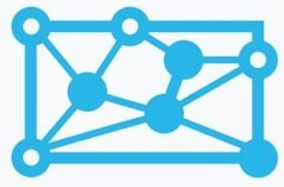


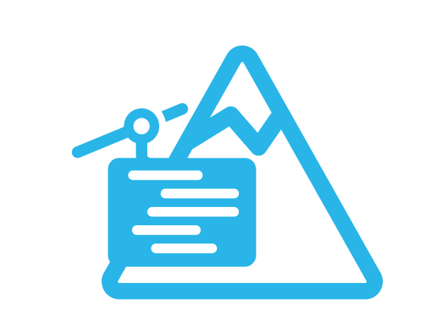
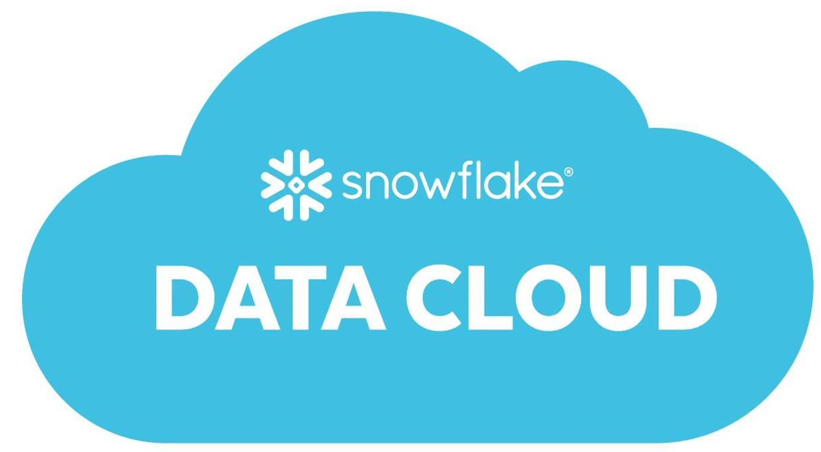
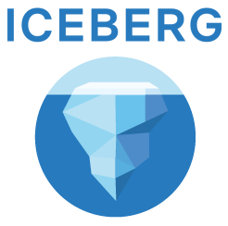
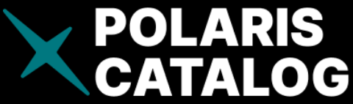

Intelligent Digital Brain on Snowflake – Scaled Enterprise AI Architecture (L2)
Enterprise-grade brain layers for continuously learning, semantically grounded, agentic execution at scale.
Experience
Employee Copilots
Analyst Workbenches
Contact Center Assist
Digital Channels
Back-office Automation
Developer & Ops Productivity
Core Design Principles
Workbench Blueprints
Snowflake Cortex Agents
Native Apps
Streamlit in Snowflake
Domain Agent Libraries
Cortex Analyst Templates
Arctic Prompts
Reusable Eval Packs
Solution Delivery & Adoption Kits
Native App Framework
Marketplace Listings
Change Management + Enablement
Industry Apps: Salesforce, ServiceNow, SAP, Workday via Snowflake Marketplace
Evergreen Learning System
Continuous improvement loop operationalized
AI Governance, Registry & Lineage
AI Observability, Monitoring & Evaluation
Responsible, Explainable & Compliant AI
AI Lifecycle Automation & Promotion
Lifecycle Scope:
Models · Agents · Prompts · Policies · Knowledge · Data · Tools
5
AI Lifecycle
Management
Model Registry
Access History
Object Tagging
RBAC/Access Policies
Cortex Analyst Evals
Query History/ Profiling
Snowflake Observability
Information Schema
Cortex GUARD
Data Quality Metrics
Snowflake Horizon
Masking Policies
Snowflake Tasks
Model Reg. Promotion
Native App Releases
Institutional Knowledge Compounding
Captures explicit, implicit, and tacit knowledge
Agent Orchestration
Industry Agents
Agent Certification & Readiness
4
Agent Ensemble
Optional: LangGraph
Cortex Agents
Snowflake Task DAGs
Cortex Analyst
Tool Use/ Function Calling
Cortex Agent Builder
Snowflake Notebooks
Snowpark Container Services
Marketplace AI Agents
Cortex GUARD
Snowflake Trust Center
Native App Certification
A2A via Snowpark REST
Model Recipe
Adaptive Learning Loop
Experiential Knowledge Acquisition
Trusted Agentic Execution
Certified agents, evidence packs, policy enforcement, secure tool execution across enterprise systems
3
Specialized Models
Cortex Fine-Tuning
Snowflake Arctic
Snowpark ML Modeling
Model Registry
Snowflake ML Functions
Dynamic Tables
Feature Store
Cortex LLM Inference
Cortex Search
Snowflake Vector Store
Document AI
Marketplace Data
Semantic Layer
Knowledge Representation
Domain Ontology Engineering
2
Domain Ontologies
Snowflake Semantic Model
Universal Search
Business Metrics Layer
Object Tagging
Cortex Search
Vector Embeddings
Semi-Structured
Knowledge Graphs via Iceberg
Snowpark
Schema Evolution
Human-in-Loop via Streamlit
Reusable Platform for Any Domain
Same core brain across industries; plug-in ontologies, data products, agent libraries
Data Accessibility
Data Products
Data Agents
1
Data Foundation
Snowflake Internal Stage
External Tables
Snowpipe Streaming
Snowflake Data Cloud
Data Marketplace Listings
Data Sharing / Clean Rooms
Cortex Analyst
Dynamic Tables
Snowpark DataFrames
Brain Infrastructure
Virtual Warehouses
Multi-Cloud
Snowpark Container Services
Private Link / VPC
Tri-Secret Secure
Business Critical Isolation
Source Systems, External Systems
Notes:
Layers 0–1: mostly Snowflake-native
Layer 2: Snowflake + graph/ontology complement
Layer 3: Snowflake first, selective external model services where needed
Layer 4: hybrid agent layer, with Snowflake as grounding and context plane
Layer 5: hybrid lifecycle and governance, not Snowflake only
NN take : Snowflake is very strong as the core intelligence and data platform, especially across data foundation, semantic grounding, search, and in-platform AI. Where it is not a full one-to-one replacement is in graph, full cloud infrastructure, API management, DevOps, and broader orchestration. That actually supports our architecture. Our design is Snowflake first for the insurance brain, with selective complements for graph, agents, workflow, and lifecycle where enterprise-grade requirements demand it
NN Summary : Use Snowflake as the primary data, semantic, and AI execution foundation, but complement it with external services where Snowflake does not provide a full graph, orchestration, container, API, or enterprise lifecycle equivalent

